Slide 1
Welcome to Rainworks
Engineers Without Borders

Slide 2

Rainworks Origin
Group started in Fall 2020
Competition hosted by Environmental Protection Agency (EPA)
Green infrastructure design challenge on college campuses
Original idea was green roof on SLC

Slide 3
Current Design
A 3D printed, waterproof box has been buried in the ground on Alumni Lawn
There is an inlet and outlet that allows rainwater to flow through the two reservoirs in the box connected by tubing
Housed inside the box are 5 different sensors:
Turbidity
Flow
pH
Soil moisture
Conductivity
The data gathered by the sensors can be used to determine whether green infrastructure is necessary in a certain area and what types of plants to put in a rain garden

Slide 4
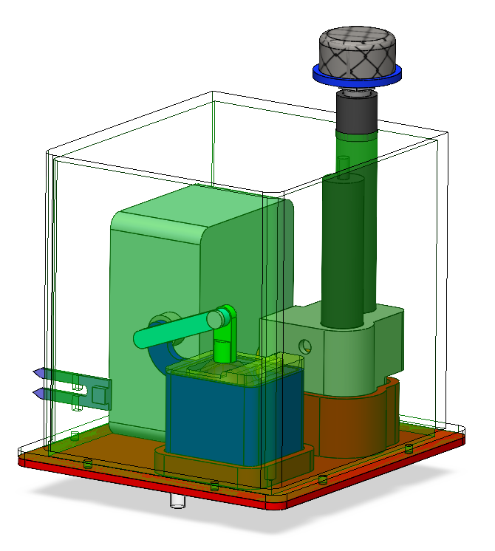
Mechanical
3D-printed box that holds all sensors and the electronics
Two reservoirs
One holds the pH sensor, conductivity, and turbidity sensors
Other holds the flow sensor
Flow sensor contains a potentiometer with a Pythagoras cup
Water enters the box through the mesh on the top
Water flows through both reservoirs before leaving out the bottom

Slide 5
Electrical
Microcontroller reads value of each sensor periodically
Analog to Digital Converter (ADC) to convert sensor signals into signals that can be read by computer
Batteries power the microcontroller

Slide 6
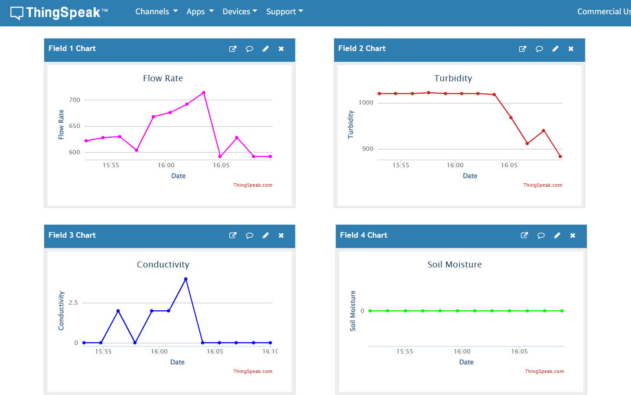
Computer Science/User Interface
Arduino code allows microcontroller to send data to Thingspeak
One channel that all the data go to
Each sensor has its own field
Data is in real-time (sometimes up to 2 minutes to update)

